Slide 1
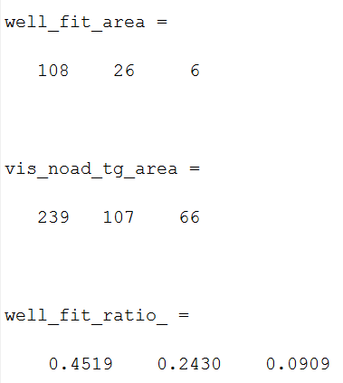
Number of well-fitted cells decreases from V1 to LM to LI
Notes:
Upregulating upper bound of k in von mises function fit did not change the number of well-fitted cells:
Some cells get larger k, but they are still not well-fitted

Slide 2
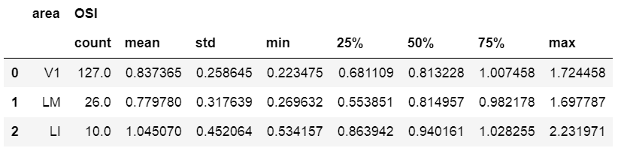
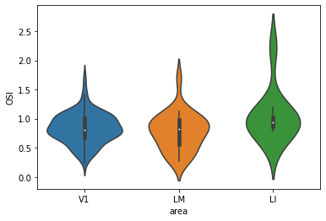
Notes:
But OSI is comparable across areas (if you only include well-fitted cells)
OSI only reflects resp to pref ori vs ortho ori

Slide 3
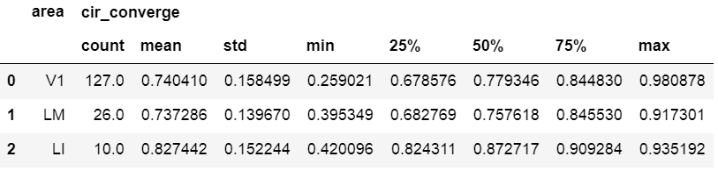
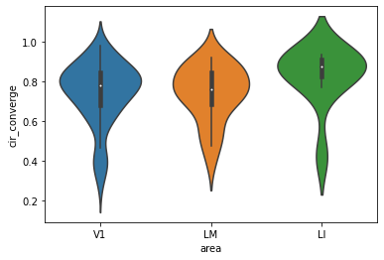
Notes:
Same if you use (1 – circular variance) as a metrics of ori-selectivity.
if cirvar is larger, 1-cirvar is smaller, and ori-selectivity is smaller all around, reflecting all oris

Slide 4
Therefore, the number of cells clearly favoring a certain orientation decreases from V1 to LM & LI
But out of those who clearly respond to gratings, their orientation selectivity are similar across areas
Are the HVA cells harder to fit due to higher SNR?

Slide 5
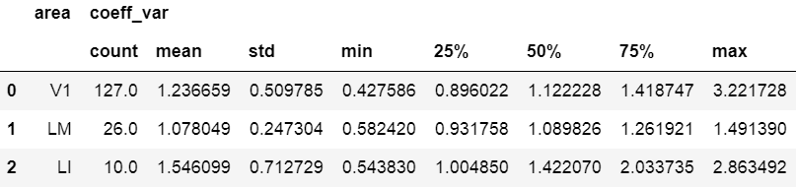
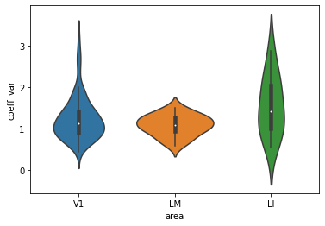
Notes:
For well-fitted cells, SNR does not vary too much across areas

Slide 6
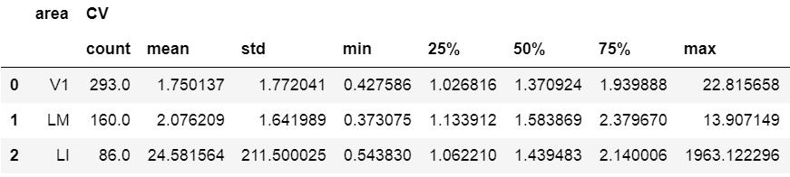
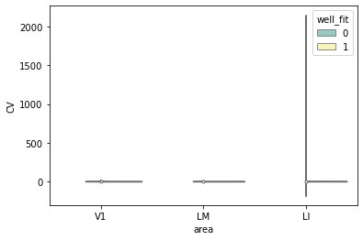
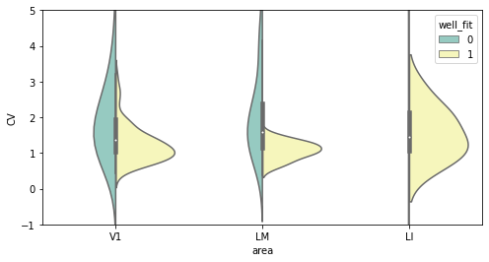
Notes:
Compared to well-fitted cells, poorly-fitted cells have much larger value and wider spread of SNR
This difference is extreme in LI. LM also exhibits the same trend. Both HVAs tend to have extreme values, which impacts the mean a lot but not the median
Therefore, HVAs have some cells with higher SNR, and their response is poorly fitted by tuning curve function

